Slide 1
Health Care Provider Quarterly Meeting
May 13, 2020
9:30 a.m. to 11 a.m.

Slide 2
Agenda Items
Welcome
Introduction of Deputy Commissioner of Legal Services
Office of Medical Advisor Update
DD and Business Process Update
Compliance and Investigations Update
Telemedicine Update
MFDR Update
Patients Medical Court Case
Q&A
Closing

Slide 3
Welcome
Cassie Brown, Commissioner Division of Workers’ Compensation

Slide 4
Introduction of Deputy Commissioner of Legal Services
Kara Mace, Deputy Commissioner
Legal Services

Slide 5
Office of Medical Advisor Update
Mary Landrum, Director
Health Care Business Management

Slide 6
Health Care Management Update
Mary Landrum, Director
Health Care Business Management

Slide 7
Medical Quality Reviews
Calendar Year 2020
0 reviews initiated
includes complaint, audit, or monitoring based reviews
assigned to MQRP members for review
5 reviews concluded
80% referred to Enforcement
20% recommended other actions
(includes letters of education, referrals to medical licensing boards, and closures with no action)
Source: Texas Department of Insurance, Division of Workers’ Compensation, data as of 04/21/20

Slide 8
DD and Business Process Update
Joe McElrath, Deputy Commissioner
Business Process

Slide 9
Compliance and Investigations Update
Debra Knight, Deputy Commissioner
Compliance and Investigations

Slide 10
CY2020 Complaints

Slide 11
CY2020 - Complaints
687 Complaints Received
70 Attendance
204 Communications
0 Fraud
150 Indemnity Benefit Delivery
171 Medical Benefit Delivery
48 Other
44 Quality of Care
927 Complaints Closed
225 Confirmed
342 DWC Education Complaint
360 Not Confirmed
*Based on complaint data as of 5/5/2020

Slide 12
Complaint Comparison
Quarter Comparison
Feb 2020 187 | Mar 2020 165 | Apr 2020 89 | Quarter Volume 441
Nov 2019 174 | Dec 2019 294 | Jan 2020 246 | Quarter Volume 714

Slide 13
DWC Fraud

Slide 14
Fraud Definition
Per Black’s Law Dictionary:
“Fraud includes any intentional or deliberate act to deprive another of property or money by guile, deception, or other unfair means.”
https://www.acfe.com/fraud-101.aspx

Slide 15
Fraud Schemes
Types of fraud the DWC Fraud and Prosecution teams investigate:
Billing for services not performed by attorneys and healthcare providers.
Under reporting employees or misclassifying high risk employees in order to obtain lower premium rates.
Working & drawing benefits.
Falsifying documents to keep from having to pay benefits.

Slide 16
CY2020 – DWC Fraud Stats
487 - Fraud referrals received
124 - Fraud cases open*
512 - Fraud cases closed
0 - Fraud referrals for prosecution
*Based on data received as of 4/15/2020

Slide 17
CY2020 – DWC Prosecution Stats
Indictments – 2
1 Health Care Provider
1 Injured Employee
*Based on data received as of 4/15/2020

Slide 18
CY2020 – DWC Prosecution Stats
Convictions – 2
1 Employer
1 Injured Employee

Slide 19
Enforcement Update

Slide 20
Enforcement Key Initiatives
Strategies DWC Enforcement uses to improve market compliance and case processing:
Using clear, express statutory authority for all enforcement cases;
Informing workers’ compensation stakeholders about compliance goals;
Partnering with Division of Workers’ Compensation program areas to foster compliance;
Assisting the Office of the Medical Advisor;
Providing swift, appropriate actions for statutory and rule violations.

Slide 21
Common Insurance Carrier Administrative Violations
Failure to pay timely indemnity benefits;
Failure to initiate TIBS;
Failure to accurately pay TIBS;
Pursuing a private claim against an injured employee;
Failure to investigate a claim;
Attorney fee billing violations; and
Failure to comply with MFDR or D&O order.

Slide 22
Enforcement Case Status for CY2020
2020 | Closed Cases | Pending Cases
Cases | 193 | 340

Slide 23
Cases Pending by Subject Type as of March 31, 2020
2020 | Health Care Provider | Insurance Carrier | Other
Cases | 80 | 215 | 45

Slide 24
Cases Closed by Disposition Type for CY2020
2020 | Health Care Provider | Insurance Carrier | Other
DWC Order | 4 | 29 | 1
Warning Letter | 27 | 100 | 28
Other | 3 | 1 | 0

Slide 25
Cases Closed by Subject Type for CY2020
2020 | Health Care Provider | Insurance Carrier | Other
Cases | 34 | 130 | 29

Slide 26
OMA Enforcement Cases
CY 2020
2 OMA referrals received in Enforcement
1 OMA case concluded by Enforcement
1 consent order/final order
0 warning letters
0 other action
31 OMA cases pending in Enforcement
1 OMA case pending at SOAH
Source: Texas Department of Insurance, Division of Workers’ Compensation, data as of 04/20/20
Notes:
Mary Landrum’s Slide

Slide 27
Telemedicine Update
Matt Zurek, Deputy Commissioner
Health and Safety

Slide 28
Telemedicine 28 TAC §133.30
Rule applies to medical billing and reimbursement for telemedicine and telehealth services provided on or after September 1, 2018
A health care provider must bill for telemedicine and telehealth services according to applicable:
Medicare payment policies, as defined in §134.203 of this title; and
provisions of Chapter 133 of this title.

Slide 29
Emergency Rule
DWC adopted new 28 Texas Administrative Code §167.1 on an emergency basis. The rule relates to telemedicine and telehealth and went into effect for physical medicine and rehab services provided on or after April 13, 2020.
Rule allows licensed HCP’s to perform physical medicine and rehabilitation services, and physical therapists, occupational therapists, and speech pathologists to bill and be reimbursed for services currently allowed under CMS telemedicine and telehealth billing codes.

Slide 30
Emergency Rule
Under Government Code §2001.034, this emergency rule may not be in effect for more than 120 days, but may be extended 60 days.

Slide 31
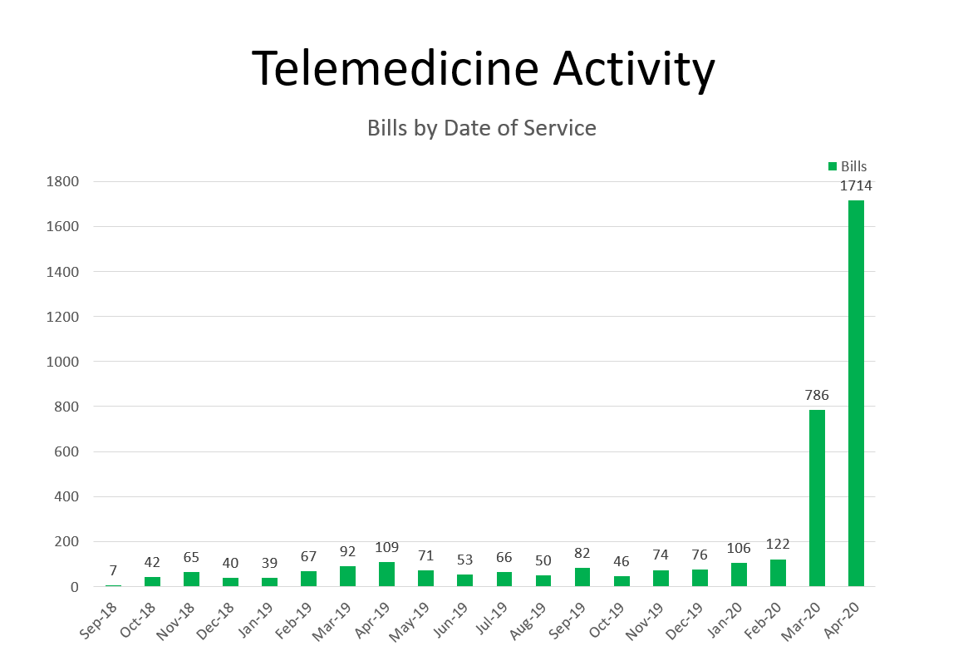

Slide 32
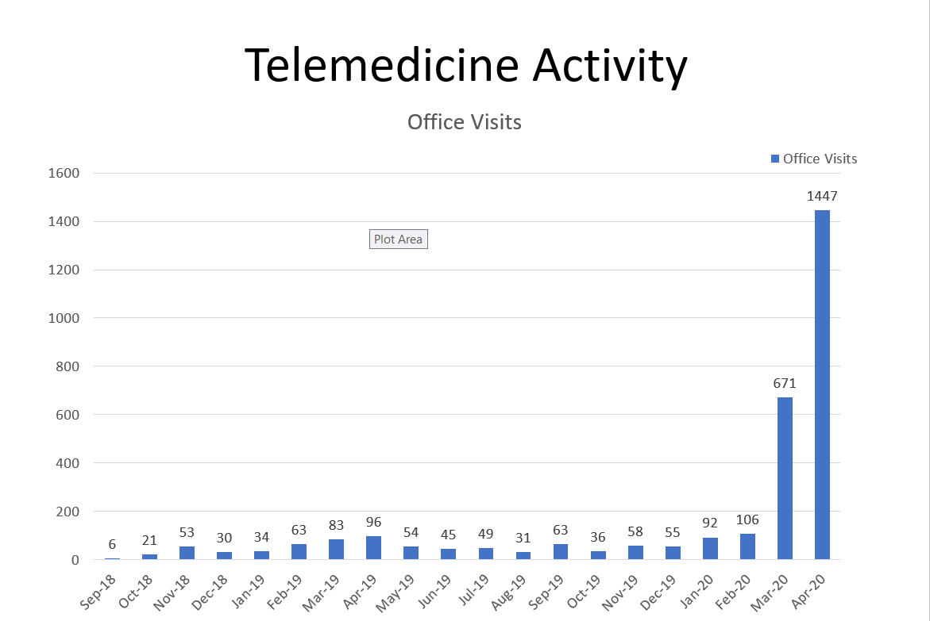

Slide 33
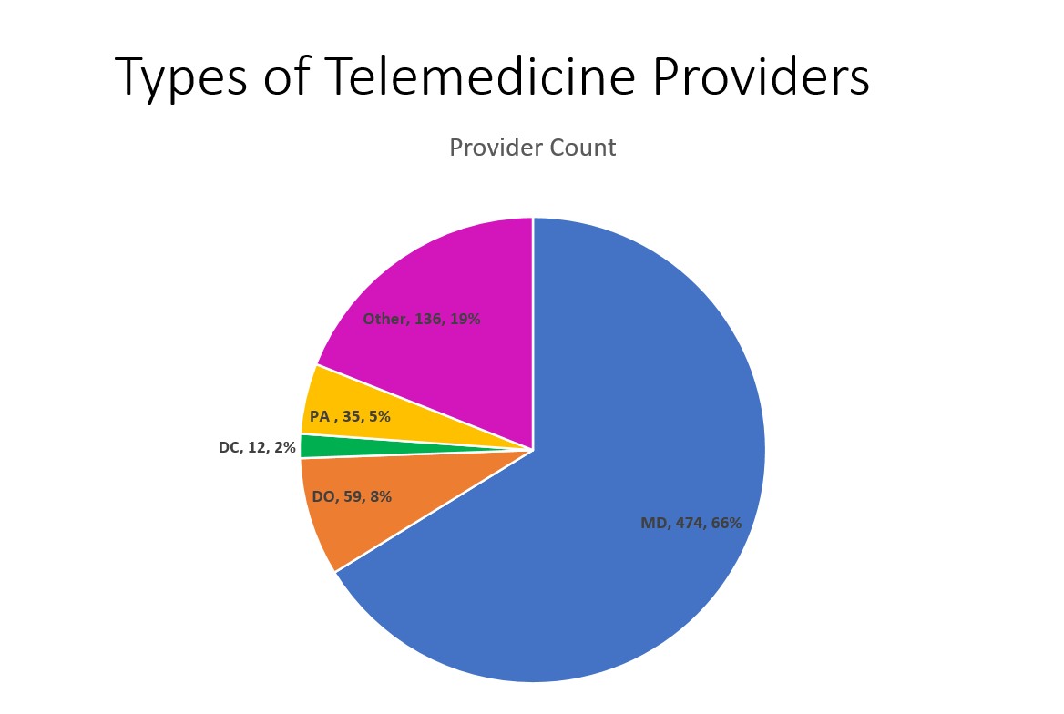

Slide 34
r

Slide 35
Telemedicine Resources
DWC Telemedicine cage:
http://www.tdi.texas.gov/wc/hcprovider/telemed.html
List of covered services:
https://www.cms.gov/Medicare/Medicare-General-Information/Telehealth/Telehealth-Codes
Adopted Rule: (Texas Register)
https://texreg.sos.state.tx.us/public/regviewer$ext.RegPage?sl=R&app=1&p_dir=&p_rloc=351110&p_tloc=&p_ploc=&pg=1&p_reg=351110&ti=28&pt=2&ch=133&rl=30&issue=04/27/2018&z_chk=

Slide 36
MFDR Update
Greg Arendt, Director
Medical Fee Dispute

Slide 37
2,120 Disputes Received Fiscal Year 2020
Pharmacy | Division Specific | Facility | Non-MFDR Issues | Air Ambulance | Professional Services | All Other | Total
367 | 335 | 303 | 275 | 262 | 216 | 362 | 2120

Slide 38
2,180 Disputes Closed Fiscal Year 2020
Pharmacy | Division Specific | Facility | Non-MFDR Issues | Professional Services | All Other | Total
523 | 377 | 348 | 322 | 259 | 351 | 2180

Slide 39
Average Days to Adjudicate a Dispute
2013 | 2014 | 2015 | 2016 | 2017 | 2018 | 2019 | 2020
1023 | 554 | 289 | 358 | 174 | 68 | 81 | 113

Slide 40
Facility Ins. Corp. v Patients Medical Center, 574 S.W. 3rd 436 (Court of Appeals, Austin, Dec. 5, 2018); Petition for Review, pending, Case No. 19-0533.
Nick Canaday,
Special Counsel

Slide 41
Statement of the Case:
Provider initiated MFDR process following insurance carrier’s partial payment of bill.
MFDR ordered additional payment. Insurance carrier requests hearing at SOAH.
Legal Issue:
Which party carries the burden of proof in the de novo contested-case hearing at SOAH?
Is it the health care provider that filed the initial request for review?
Is it the party that requested a benefit review conference and, ultimately, that the matter be docketed with SOAH?

Slide 42
Statement of the Case:
The health care provider is the party seeking “affirmative relief” (in the form of reimbursement) throughout the entire review process, despite an insurance carrier’s challenging of a reimbursement award at any given stage within the MFDR context.
The burden of proof should always remain with the health care provider regardless of who prevailed in the underlying Medical Dispute Resolution.

Slide 43
Q&A

Slide 44
Closing
Cassie Brown, Commissioner
Division of Workers’ Compensation

