Slide 1
Provider System
Changes
August 2019 Training for Designated Doctors

Slide 2
Move to TXCOMP
New system for health care providers and designated doctors:
TXCOMP Claims and Coverage system (TXCOMP).
What’s changing?
    New password requirements
    Allows designated doctors to add a scheduling company or an administrator to manage their profile
Why is it changing? DWC is consolidating and modernizing its two main enterprise systems.
When is it changing? Monday, August 19, 2019.

Slide 3
Move to TXCOMP
How does this affect me?
  All users with existing access to the Provider system will have access to TXCOMP.
  Update your bookmarks to the new web site:
    https://appscenter.tdi.texas.gov/TXCOMPWeb/common/home.jsp
  There is no change to the designated doctor appointment offer process.

Slide 4
TXCOMP Passwords
On August 19, the system will require a new password format.
  Minimum of 10 characters that must include:
      Uppercase letter (A through Z)
      Lowercase letter (a through z)
      Numeral (0 through 9)
      Special character (such as !, $, #, %)

Slide 5
New!
Currently, doctors can only associate one administrator to manage their profile.
In the new system, doctors can choose an administrator or a company to manage their profile.
The company can give their employees access to manage a doctor’s profile.

Slide 6
Designated Doctor Agent Relationships
NEW!

Slide 7
TXCOMP Terminology
A few system terms:
People are called Individuals.
Companies are called Organizations.
Scheduling companies and doctor admins are called Agents.
The system assigns a Customer ID to each individual and organization. It’s located at the top of the profile page.

Slide 8
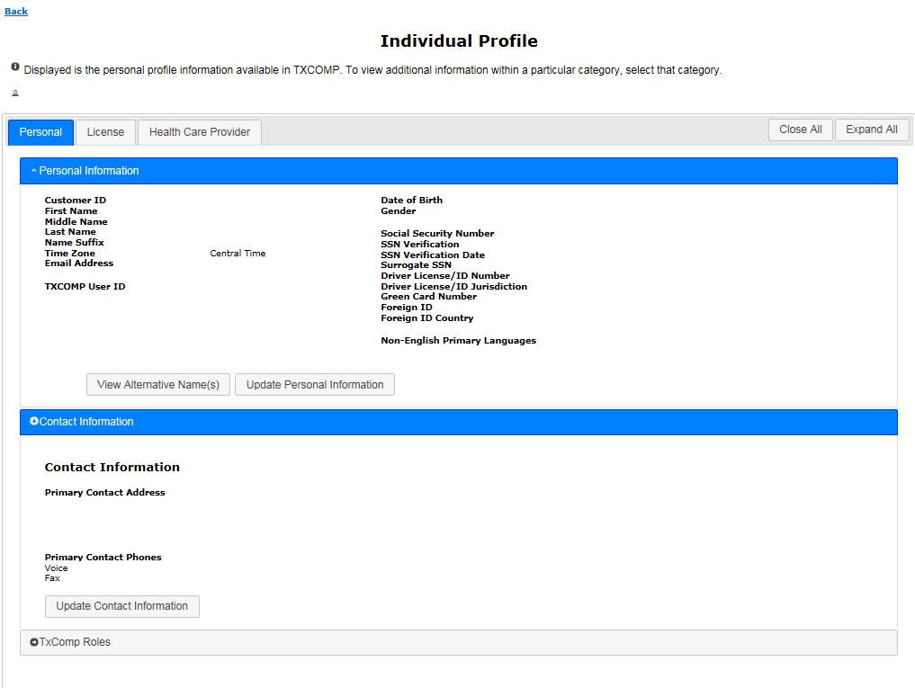
Doctor’s Individual Profile Layout
NEW!
Tabs now organize information

Slide 9
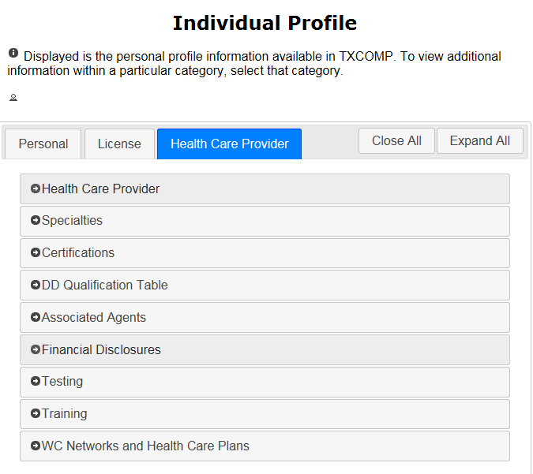
Doctor’s Individual Profile Layout
NEW!
NEW!
Sections expand and collapse

Slide 10
Designated Doctor Agents
The Doctor Administrator role:
  Designated doctors can assign either a person (individual) or a company (organization) to manage their online profile, including examination locations.
  If the designated doctor selects an organization to act as their agent, all approved staff associated with that organization can manage the doctor’s profile.
  A designated doctor can still only have one agent (individual or organization) at a time.

Slide 11
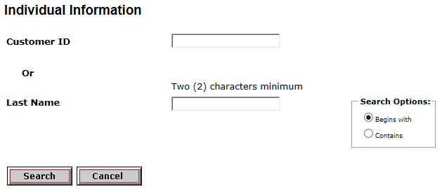
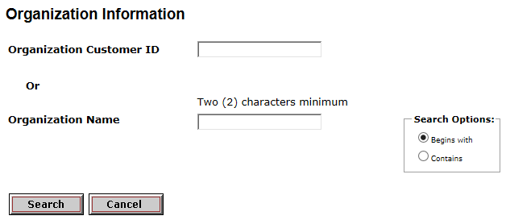
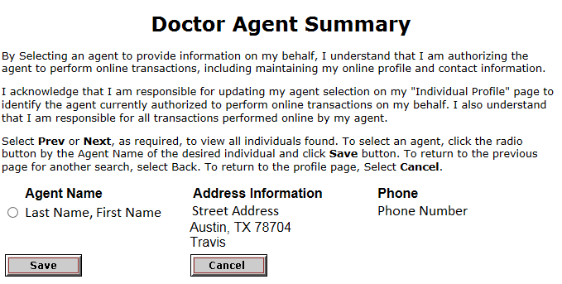
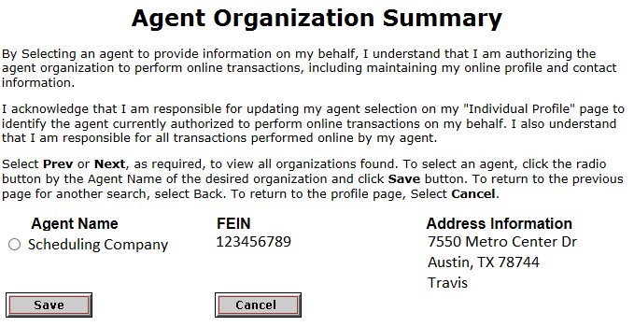
Selecting a Designated Doctor Agent
NEW!
Individual
Organization
Search
Select
Save
Search
Select
Save

Slide 12
Doctor: Agent Selection
If you don’t find your agent in the system:
  Person (individual): tell them to submit an Online Access Request form at:
  https://appscenter.tdi.texas.gov/TXCOMPWeb/common/home.jsp
  Company (organization): tell your scheduling company to submit the DWC Form-120, Designation of Administrative Services Company Administrator to DWC.
    https://www.tdi.texas.gov/forms/form20numeric.html

Slide 13
How to get help
Need help with a technical issue or login?
Call the TXCOMP help line: 888-4-TXCOMP (489-2667)
Or send an email to TXCompHelp@tdi.texas.gov:
Describe the actions you were trying to do when the issue happened and include a screen shot if possible.

